Slide 1
A Linked Data Approach To SpokenWeb Collections
Francisco Berrizbeitia
Tomasz Neugebauer

Slide 2
Agenda
Overview
Brief Overview
How does Swallow handle linked data ?
Previous work:
Sara Barnard report on mapping the SpokenWeb schema
Contents field widget
Demo
Swallow to Quickstatements to Wikidata
The SGWU Reading Series in Wikidata
Discussion

Slide 3
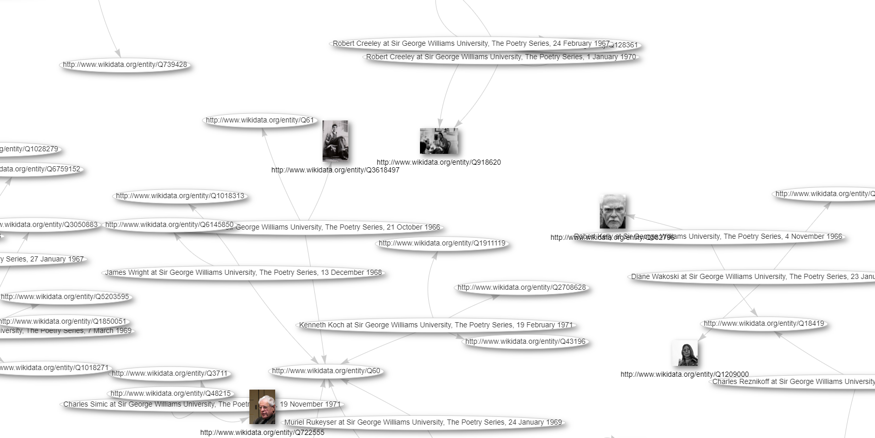
Why Linked Data ?
Interoperability Linked data allows different systems and datasets to be integrated and interconnected
Reusability Linked data is designed to be reusable, enabling different applications and services to access and reuse the same data in different contexts.
Improved search and discovery Linked data enables more sophisticated search and discovery capabilities, enabling users to find and access relevant data more easily.

Slide 4
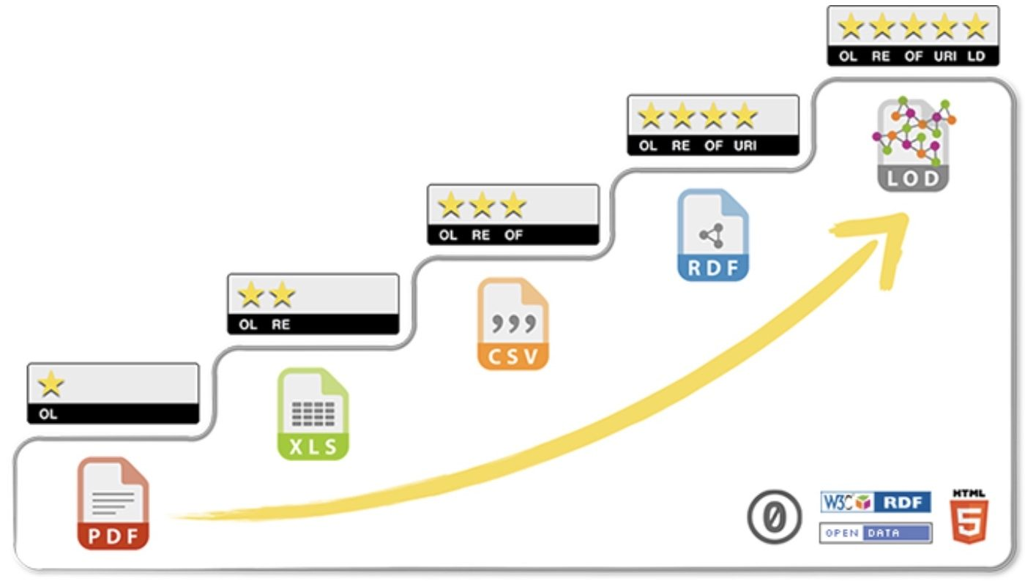
SpokenWeb Collections as 5 Star Data

Slide 5
How does linked data looks like ?
URI
URI
URI / Literal
Swallow link | Recording Date Property | Recording date value
https://d.library.concordia.ca/swallow2/item/14927 | https://www.wikidata.org/wiki/Property:P10135 | 1966 10 21
 | Instance Of | Analog Recording
https://d.library.concordia.ca/swallow2/item/14927 | https://www.wikidata.org/wiki/Property:P31 | https://www.wikidata.org/wiki/Q7207537

Slide 6
How does Swallow handle linked data ?

Slide 7
How does Swallow handle linked data ?
Swallow URL
Field
Vocabulary

Slide 8
How does Swallow handle linked data ?

Slide 9
Previous Work
Sara Barnard report on mapping the SpokenWeb schema

Slide 10
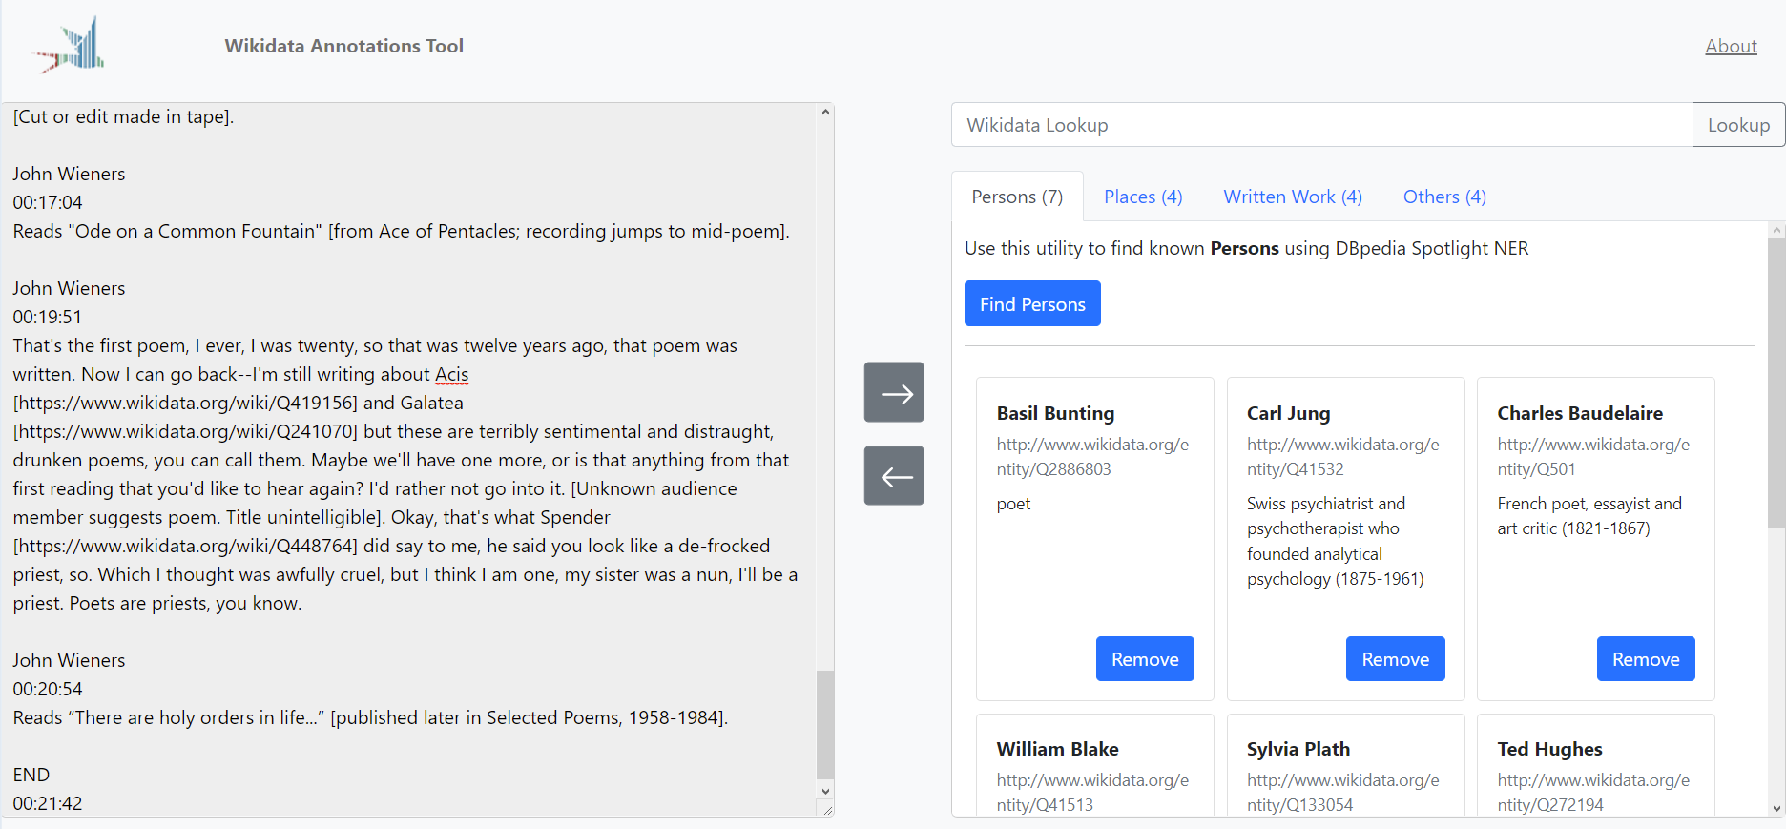
Previous Work

Slide 11
DEMO

Slide 12
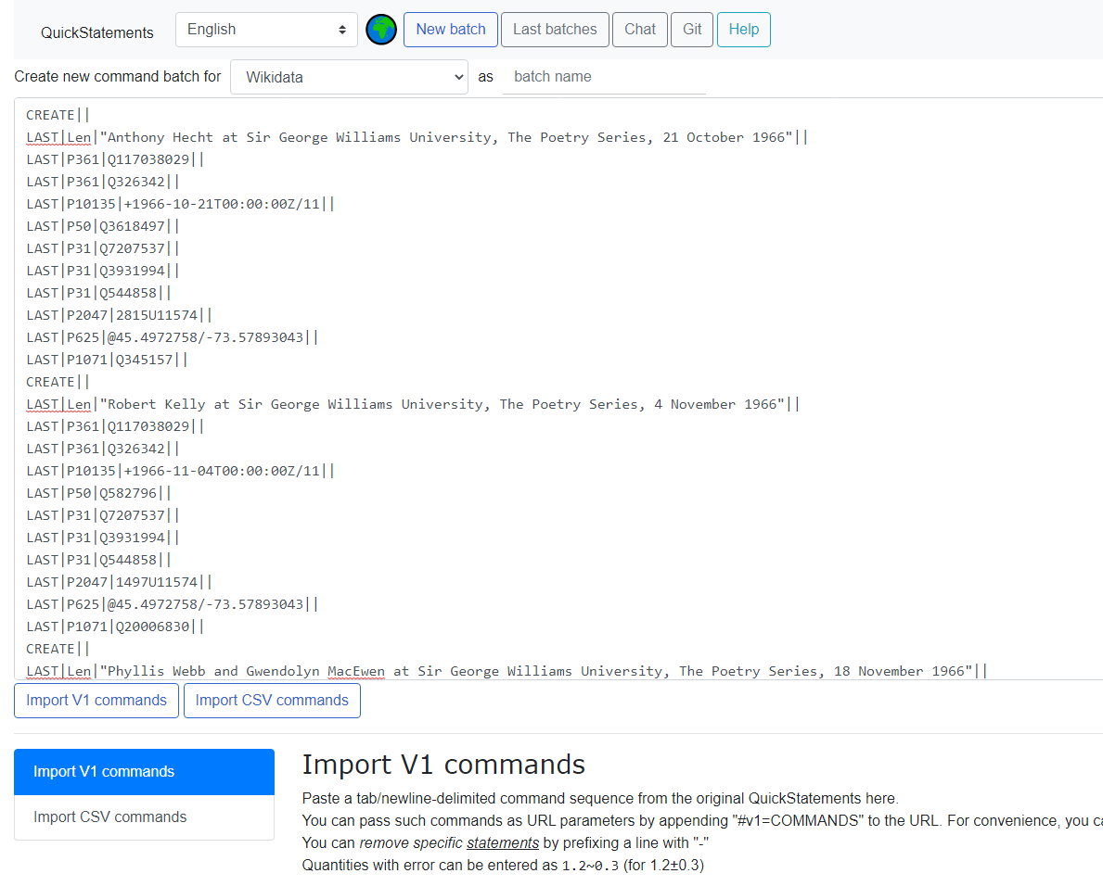
WIKIDATA IMPORT
Map schema to Wikidata entities and properties
Write a custom export service to transform “swallow triplets” to quick statements
Gain the rights to use quickstaments
Run the generated script
Design some interesting queries and visualization to showcase some of the linked data features

Slide 13
WIKIDATA IMPORT
What we learned
Is time consuming and not always possible to find a suitable property.
The no way to describe the “aboutness” of the records.
Suggesting properties is a complicated and long process.
Adding entities is extremely easy and quick.
Quickstatements works very well.

Slide 14
Visualization Ideas
TIME

Slide 15
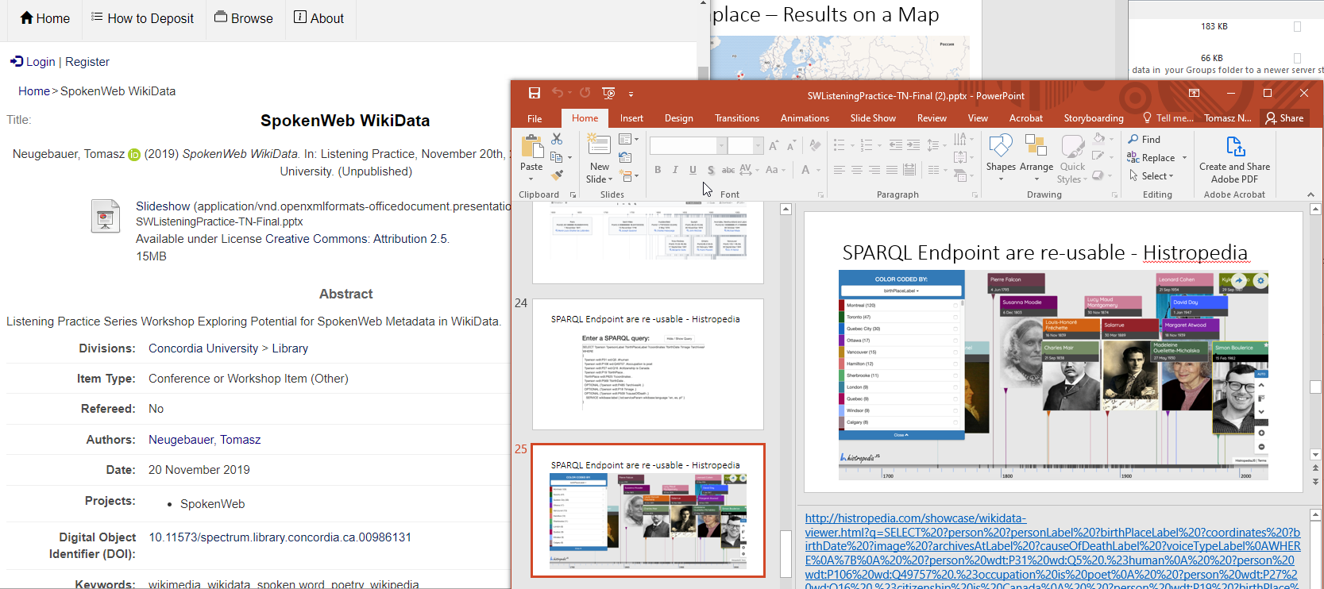
Standing on the shoulders
Visualization Ideas | Time
Notes:
https://spectrum.library.concordia.ca/id/eprint/986131/
http://bit.ly/SWtimeline1

Slide 16
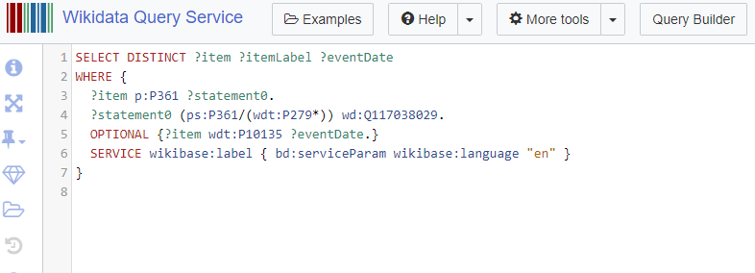
Visualization Ideas | Time
Notes:
https://query.wikidata.org/#SELECT%20DISTINCT%20%3Fitem%20%3FitemLabel%20%3FeventDate%0AWHERE%20%7B%0A%20%20%3Fitem%20p%3AP361%20%3Fstatement0.%0A%20%20%3Fstatement0%20%28ps%3AP361%2F%28wdt%3AP279%2a%29%29%20wd%3AQ117038029.%0A%20%20OPTIONAL%20%7B%3Fitem%20wdt%3AP10135%20%3FeventDate.%7D%0A%20%20SERVICE%20wikibase%3Alabel%20%7B%20bd%3AserviceParam%20wikibase%3Alanguage%20%22en%22%20%7D%0A%7D%0A

Slide 17
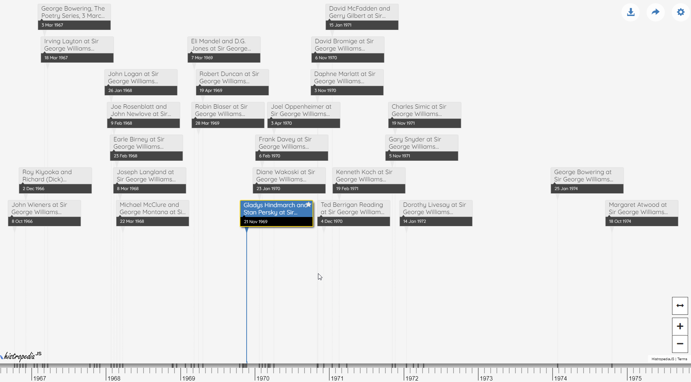
Visualization Ideas | Time
Notes:
https://js.histropedia.com/apps/query-timeline/index.html?q=SELECT%20DISTINCT%20?item%20?itemLabel%20?eventDate%0AWHERE%20%7B%0A%20%20?item%20p:P361%20?statement0.%0A%20%20?statement0%20(ps:P361/(wdt:P279*))%20wd:Q117038029.%0A%20%20OPTIONAL%20%7B?item%20wdt:P10135%20?eventDate.%7D%0A%20%20SERVICE%20wikibase:label%20%7B%20bd:serviceParam%20wikibase:language%20%22en%22%20%7D%0A%7D%0A&d=3&md=true&g=personLabel&l=item&t=itemLabel&s=eventDate&i=image&mc=500&v=t

Slide 18
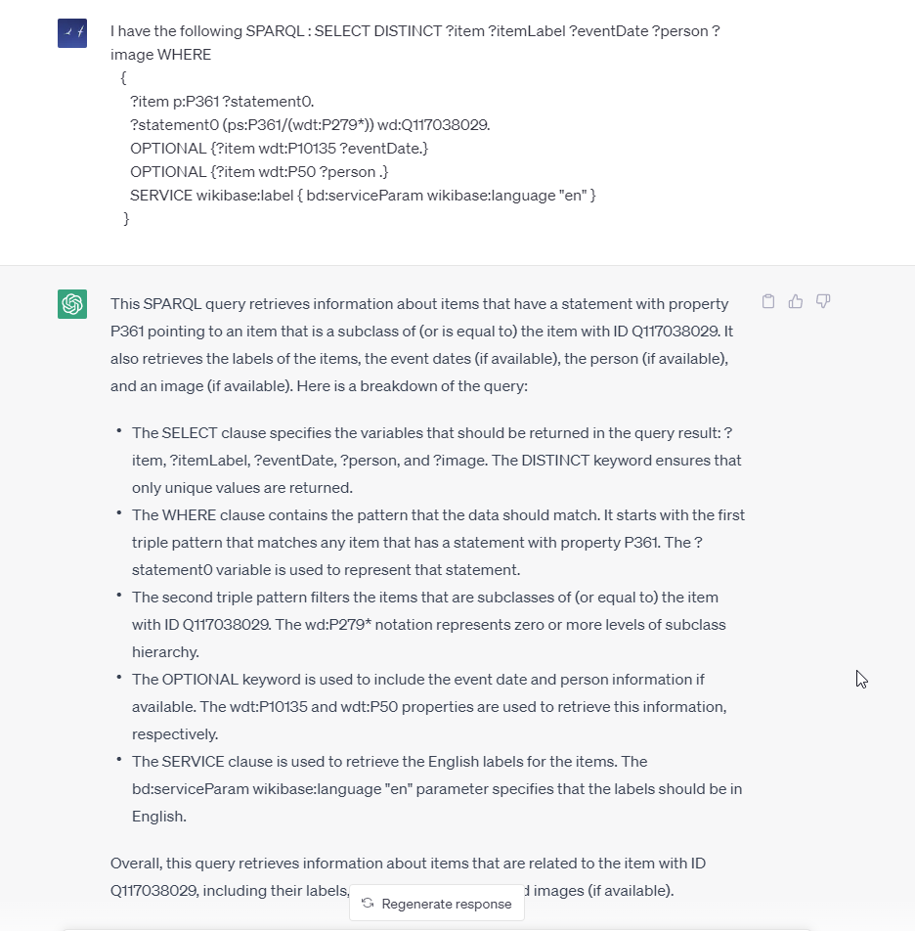
Visualization Ideas | ChatGPT can help

Slide 19
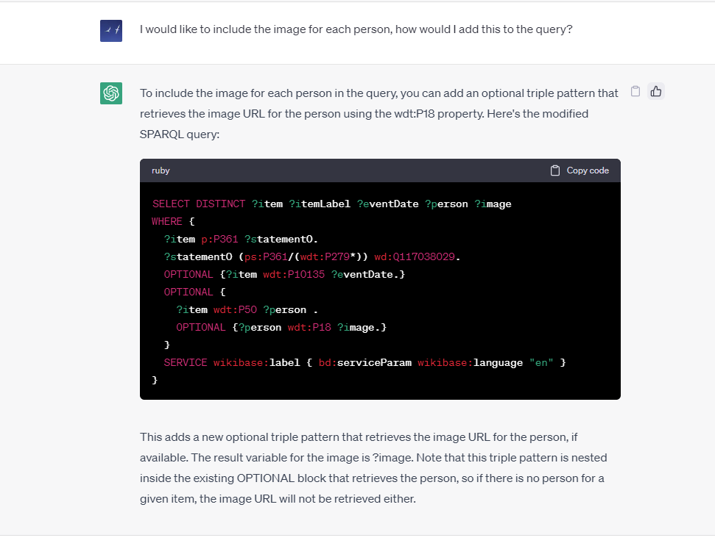
Visualization Ideas | ChatGPT can help

Slide 20
Notes:
https://js.histropedia.com/apps/query-timeline/index.html?q=SELECT%20DISTINCT%20?item%20?itemLabel%20?eventDate%20?person%20?image%0AWHERE%20%7B%0A%20%20?item%20p:P361%20?statement0.%0A%20%20?statement0%20(ps:P361/(wdt:P279*))%20wd:Q117038029.%0A%20%20OPTIONAL%20%7B?item%20wdt:P10135%20?eventDate.%7D%0A%20%20OPTIONAL%20%7B%0A%20%20%20%20?item%20wdt:P50%20?person%20.%0A%20%20%20%20OPTIONAL%20%7B?person%20wdt:P18%20?image.%7D%0A%20%20%7D%0A%20%20SERVICE%20wikibase:label%20%7B%20bd:serviceParam%20wikibase:language%20%22en%22%20%7D%0A%7D%0A&d=3&md=true&g=personLabel&l=item&t=itemLabel&s=eventDate&i=image&mc=500&v=t

Slide 21
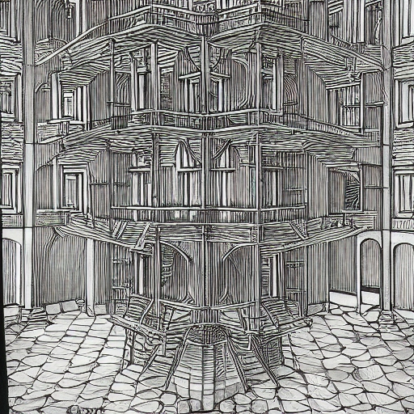
Visualization Ideas
PLACE

Slide 22
Visualization Ideas | Place
Notes:
https://w.wiki/6cTn

Slide 23
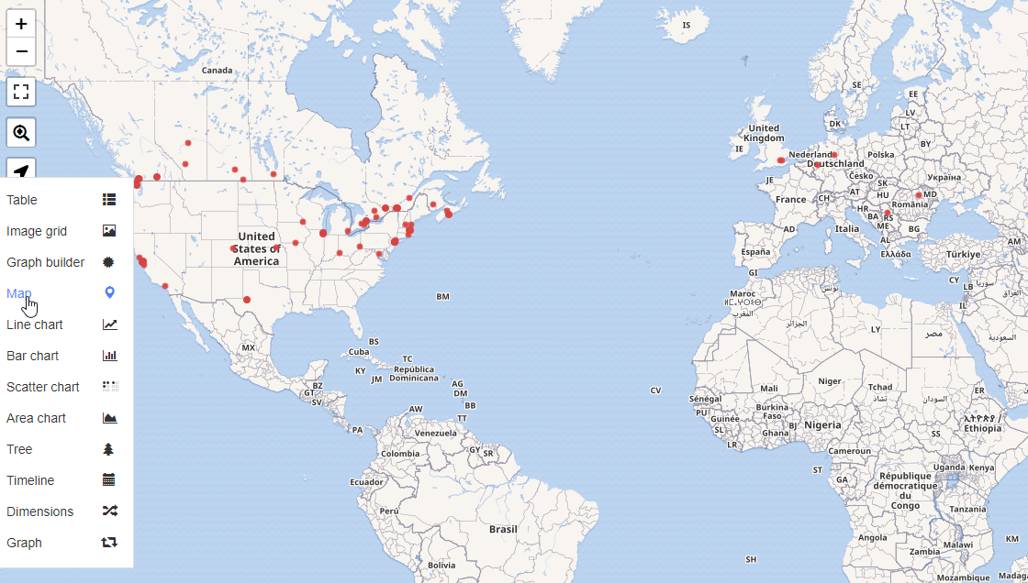
Visualization Ideas | Place
Notes:
https://w.wiki/6cTk

Slide 24
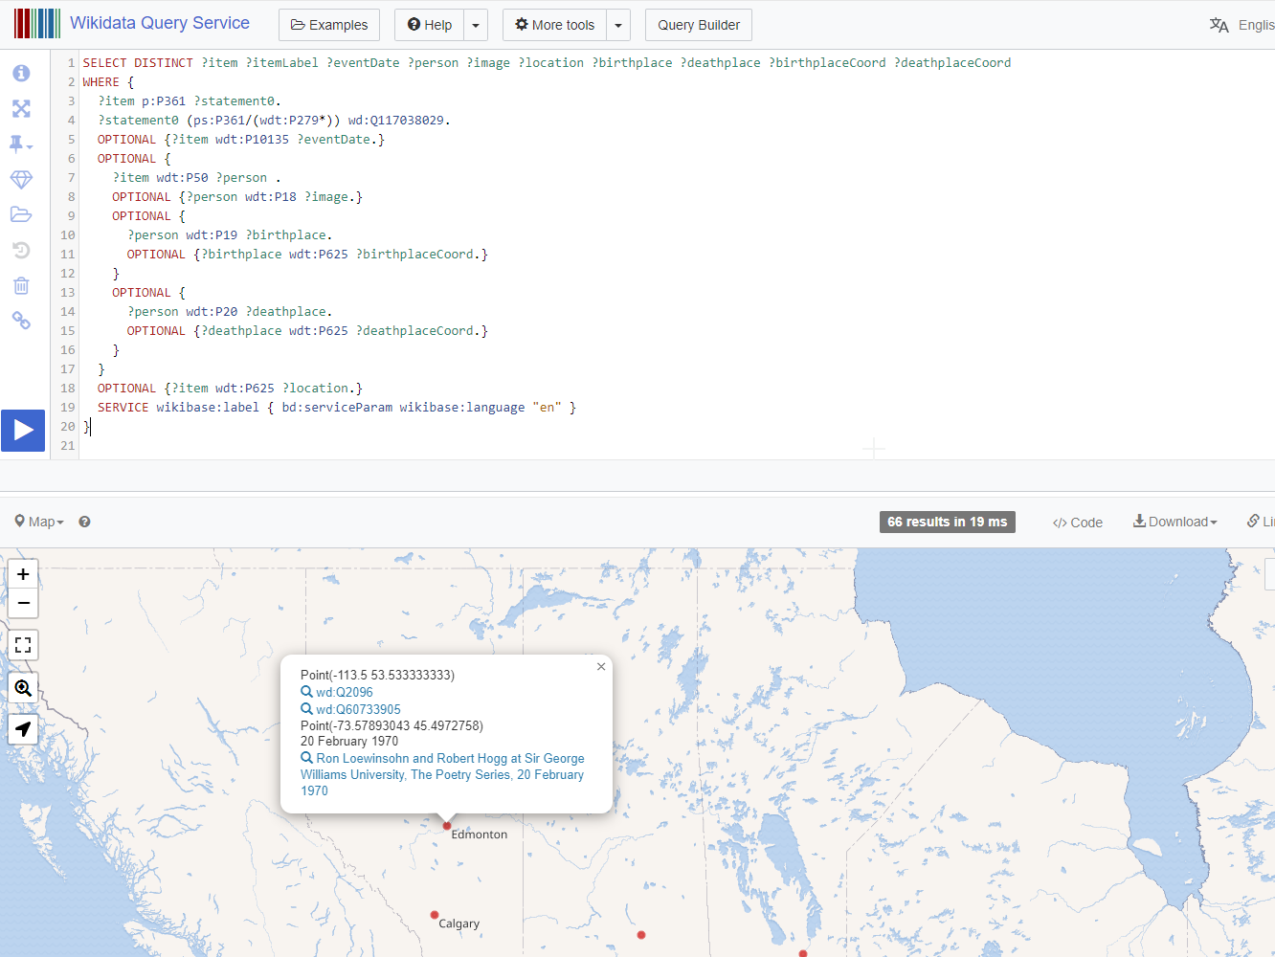
Visualization Ideas | Place
Notes:
Robert Hogg was born in Edmonton

Slide 25
DISCUSSION

Slide 26
DISCUSSION
Can we see uses and advantages in reshaping our metadata and make it available as linked data?
Should we upload more collections to Wikidata ? Collaborate improving the map ?
Should we create entries for people or venues not currently on Wikidata ?
Should we create and maintain a local Wikibase that replicates the whole schema including the contents fields ? What could be some use cases for it ?

Slide 27
A Linked Data Approach To SpokenWeb Collections
Francisco Berrizbeitia
Tomasz Neugebauer

