Slide 1
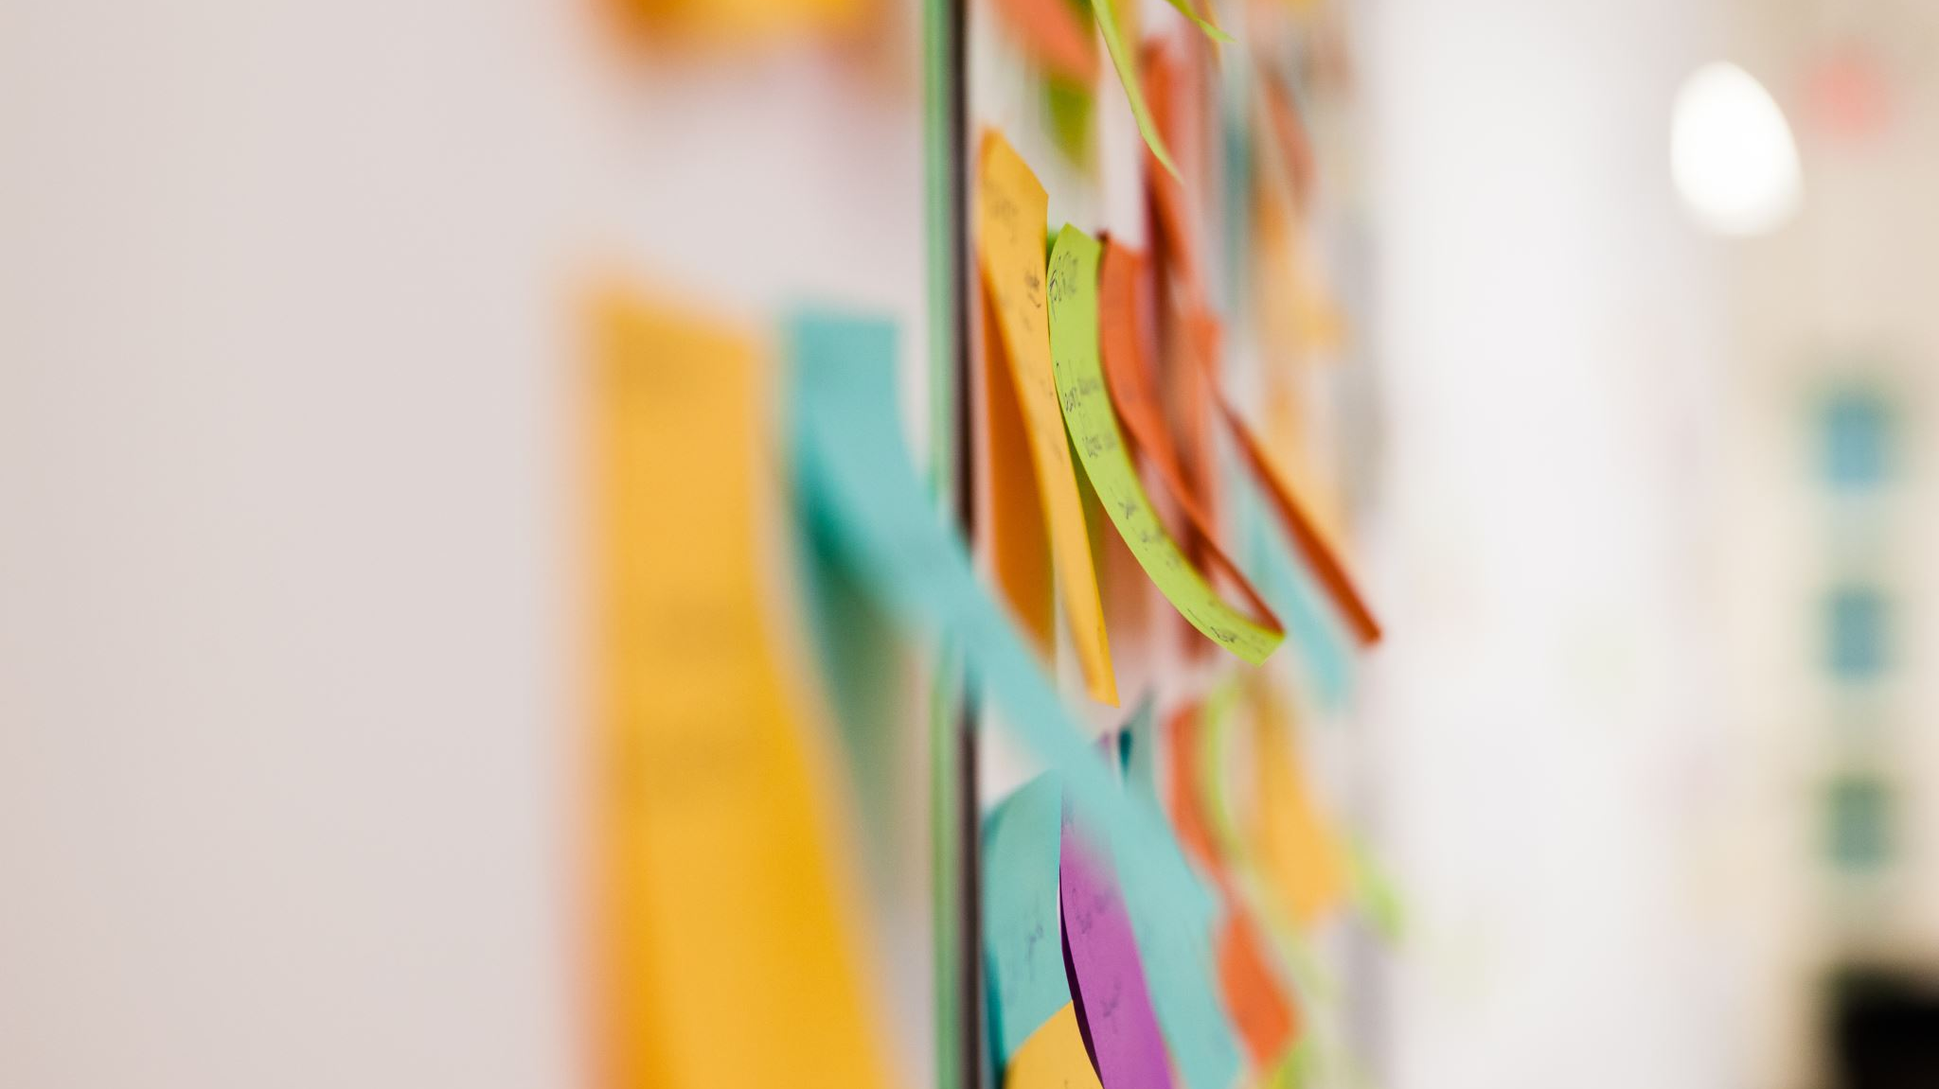
At What Point(s) in the Research Lifecycle Can an
Arts Library Facilitate Visual Art Research?
John Latour Teaching & Research Librarian – Fine Arts Concordia University, Montreal, Canada john.latour@concordia.ca
ARLIS/UK & Ireland
Norwich 2023

Slide 2
Outline
Section 1. Presentation question & response
Section 2. Context
Artexte’s research residency program
Research project: Who Was Who Was Who in Contemporary Canadian Art
A research lifecycle for the visual arts (proposed)
Section 3. Mapping Artexte’s research support within the research lifecycle
Section 4. Summary and broader implications

Slide 3
Section 1. Presentation question & response

Slide 4
Presentation question & response
At What Point(s) in the Research Lifecycle Can an Arts Library Facilitate Visual Art Research?
Through the use of concrete examples from an ongoing research project that was initiated during a residency at Artexte, I hope to show that an arts library can facilitate visual art research throughout the entire research lifecycle in numerous and invaluable ways.

Slide 5
Section 2. Context
Artexte’s Research residency program
Research project: Who Was Who Was Who in Contemporary Canadian Art
A research lifecycle for the visual arts (proposed)

Slide 6
Artexte’s research residency
Artexte collection:
7,500 artists’ files (Canadian & international)
11,000 documentary files for arts organizations, disciplines, subjects, etc.
Art journal collection
Special Collections
Research residencies
Duration: 3-6 months
Collection-based
Reference support
Workspace
Funding
Public output(s)
Fig. 1. Artexte’s “About us” webpage, https://artexte.ca/en/about-us/.

Slide 7
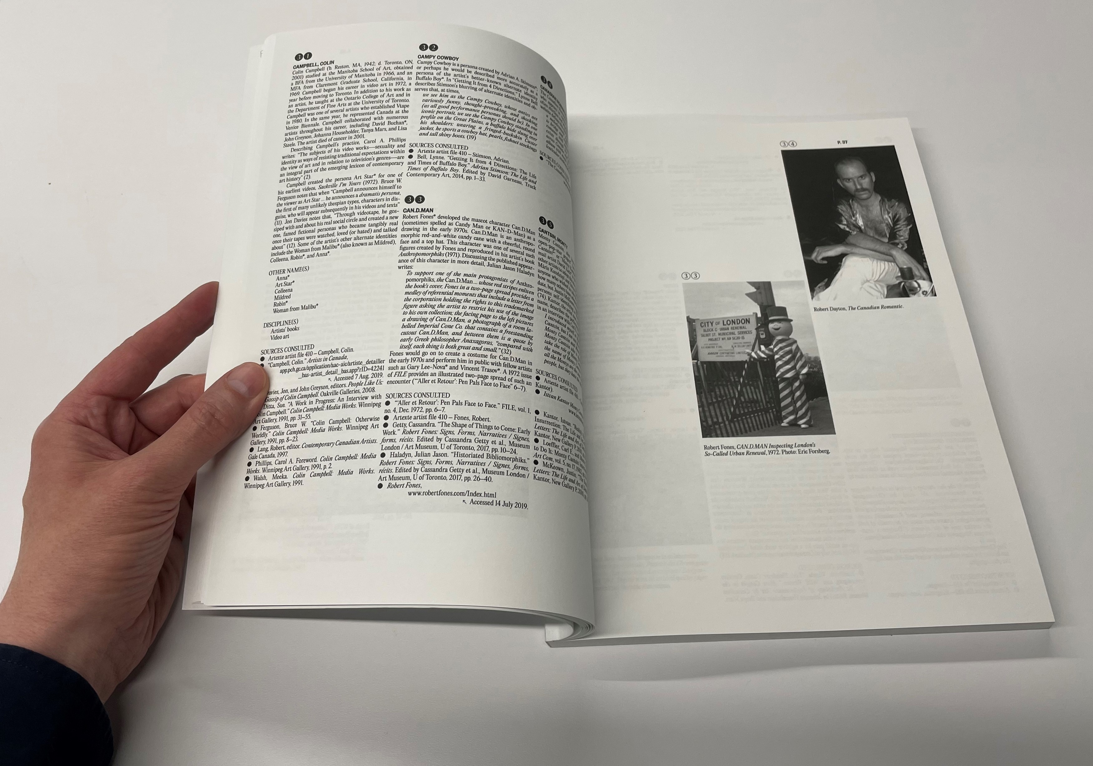
Research residency project Who Was Who Was Who in Contemporary Canadian Art
2018 spring / summer residency to explore Canadian artists who make use of alternate identities in their art.
Outputs:
2018: blog interview
2020: virtual workshop
2023: Bilingual artists’ biographical dictionary
OA texts & images licensed to Creative Commons
Print and e-book versions
Co-published with Artexte
Fig. 3. WWWWW maquette,
Robert Fones, CAN.D.MAN Inspecting London’s So-Called Urban Renewal, 1972. Photo: Eric Forsberg; and Robert Dayton, The Canadian Romantic.

Slide 8
The research lifecyleo in Contemporary Canadian Art
The research lifecycle is an outline of the steps taken during a research project. Although the exact type and order of stages varies between institutions and individual projects, each example of a lifecycle follows broadly the same points from conception to sharing the final results. The stages common at any one institution determine the support the institution provides to its community. ¹
¹ Claire Sewell, The No-Nonsense Guide to Research Support and Scholarly Communication (London: Facet Publishing, 2020), 8.

Slide 9
A research lifecycle for the visual arts
(proposed)
The spark of an original thought or question: Often in relation (or in reaction) to something else
Initial idea or question
Preparatory groundwork:
Grant writing / lit. review
Identifying objectives & goals
Defining the project’s scope
Identifying research methods & potential collaborators
Research ethics approval
Sharing:
Open access
CC licensing
Online presence
Reuse & inspire
Plan
& design
It’s worth highlighting:
Book launches, interviews or other public activities
Submit for reviews, awards, etc.
Distribution
Carrying out research:
Archival, bibliographic, historic research, etc.
Writing
Experimentation & artmaking
Promote
Explore & create
Going public:
Publishing blogs, articles, book chapters, monographs, etc.
Exhibitions, talks, performances, etc.
It’s a keeper:
Add to a collection
Legal deposit
Self-archive in institutional repository, professional website or other online resources
Checking in:
Analyzing progress with original objectives & goals, etc.
Feedback from collaborators or colleagues
Dealing with setbacks
Preserve
& document
Reflection (successes & failures)
Output
Fig. 4. Research lifecycle (Visual arts)

Slide 10
Section 3. Mapping Artexte’s support of WWWWW within the research lifecycle

Slide 11
Mapping Artexte’s support
Initial idea or question
Sharing:
Open access
CC licensing
Online presence
Artexte to do all of the above
Preparatory groundwork:
Identifying potential collaborators
Artexte accepted residency proposal
Artexte accepted publication prospectus
Reuse & inspire
Plan
& design
It’s worth highlighting:
Book launches etc.
Submit for reviews etc.
Distribution
Artexte to do all of the above
Carrying out research:
Archival, bibliographic, historic research, etc.
Artexte facilitated bibliographic research with reference services
Residency provided workspace
Promote
Explore & create
Going public:
Publishing blogs […] etc.
Artexte published a blog & co-published WWWWW
It’s a keeper:
Add to a collection
Artexte to do this (and to catalogue)
Legal deposit
Artexte to do
Checking in:
Feedback from collaborators or colleagues
Artexte agreed to co-publish, coordinate with designers and artists
Preserve
& document
Reflection (successes & failures)
Output
Fig. 5. Mapping Artexte’s support

Slide 12
Section 4. Summary and broader implications

Slide 13
Summary
The research lifecycle presents research as a process comprised of distinct but related stages. It can help researchers to visualize how their work is carried out, and how research continues beyond the output stage. The research lifecycle can also serve as a tool for libraries to see where and how they support research. By mapping Artexte’s research support for my residency project throughout the entire research lifecycle, I hope that it is indicative of how art libraries can contribute to visual arts research in numerous and invaluable ways.
Broader implications
[…] the research lifecycle is actually a strategic roadmap, a quick way of validating the academic library’s journey to strategic relevance and alignment. Research services not yet provided thus become strategic opportunities. In those cases where another department on campus already provides a particular service, the library can develop a strategic partnership. Thus the research lifecycle not only highlights what the library ought to do, what services it ought to offer, but it also offers potential partners.²
² Dan Maxwell, “The Research Lifecycle as a Strategic Roadmap.” Journal of Library Administration 56, no. 2 (2016): 121, https://doi.org/10.1080/01930826.2015.1105041

Slide 14
List of references + further reading
“About Us.” Artexte. https://artexte.ca/en/about-us/.
“Artexte’s Research Residency Program. Annual Call for Proposals.” Artexte. Published on Aug. 22, 2023. https://artexte.ca/en/2022/08/annual-call-for-proposals/. Cridford, Tom, and Christie Walker. Painting the Road to Research Data Management at the RCA. Presentation, RDMF20: RDM and Data Sharing/Openness in the Arts – Virtual Forum, London, UK, 3 June 2020. https://researchonline.rca.ac.uk/4411/
Latour, John. Who Was Who Was Who in Contemporary Canadian Art / Qui était qui était qui dans l’art contemporain canadien. Montreal: John Latour + Éditions Artexte, 2023.
MacDonald, Corina, Tomasz Neugebauer, and John Latour. “The e-artexte Digital Repository: Promoting Open Access in the Canadian Contemporary Arts Research and Publishing Community.” Art Libraries Journal 39, no. 1 (2014): 10-16. doi:10.1017/S0307472200018125.
Maxwell, Dan. “The Research Lifecycle as a Strategic Roadmap.” Journal of Library Administration 56, no. 2 (2016): 111-123. doi:10.1080/01930826.2015.1105041. “Research Data Management Toolkit.” JISC. Last modified July 26, 2021. https://www.jisc.ac.uk/guides/rdm-toolkit
Sewell, Claire. The No-Nonsense Guide to Research Support and Scholarly Communication. London: Facet Publishing, 2020.

Slide 15
Thank you!
Questions?
John Latour Teaching & Research Librarian – Fine Arts Concordia University, Montreal, Canada john.latour@concordia.ca

