Slide 1
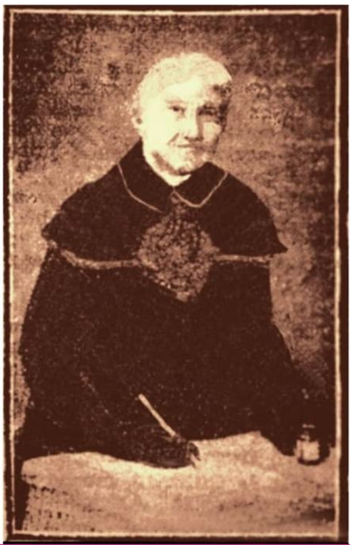

The case of
Supporting global equity in documentary heritage with a free, minimal computing solution for creating sustainable and accessible digital exhibitions
Francisco Berrizbeitia
Mariana Libertad Suárez
Pamela Carson
Zulima (Lina López de Aramburu), 1825 – 1907

Slide 2
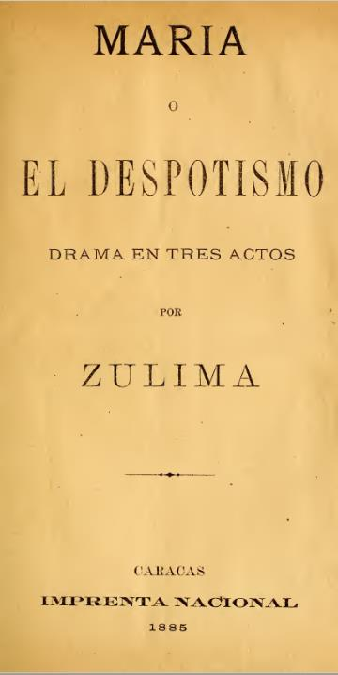
Agenda
The challenge and literature review (Pam)
The Zulima collection and context (Mariana)
The technical solution and next steps (Francisco)

Slide 3
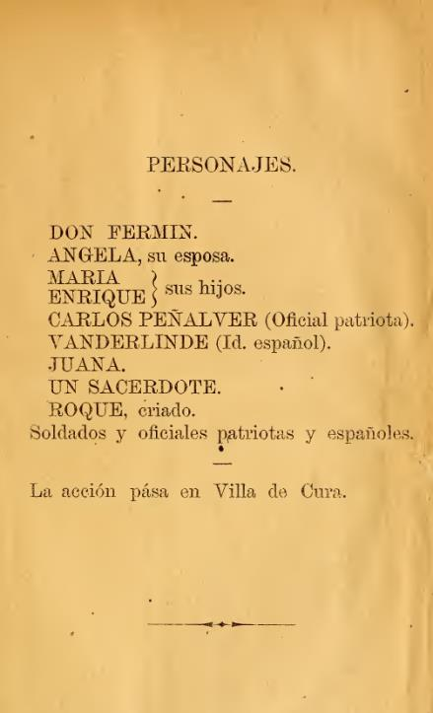
Problem statement
How can we provide easy, no-cost, sustainable tools to get at-risk archives online and maximize access to documentary heritage?
Students don’t study sources; Researchers don’t write about it
Sources cannot be accessed

Slide 4
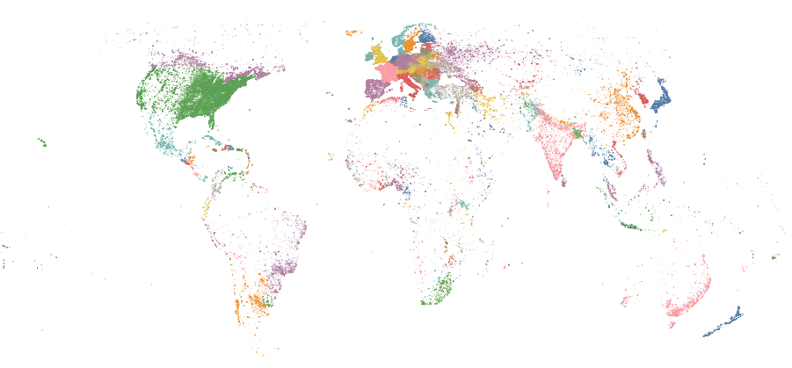
“Notable people” by birthplace
(3500 BC – 2018 AD)
Laouenan et al. (2022). A cross-verified database of notable people, 3500BC-2018AD. Scientific Data, 9(1).

Slide 5
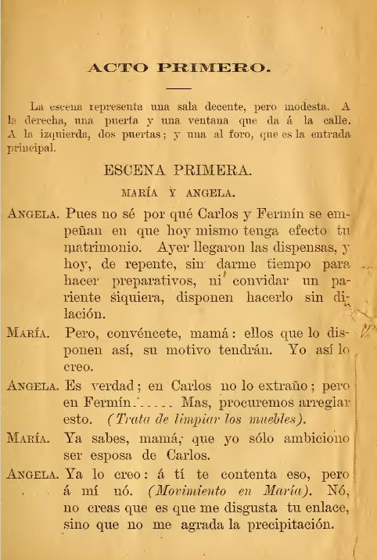
Some relevant themes in archives research
Post-custodial era in archives
Repatriation of archives
Digital turn, linked data
Community archives
Activism, agency, and autonomy

Slide 6
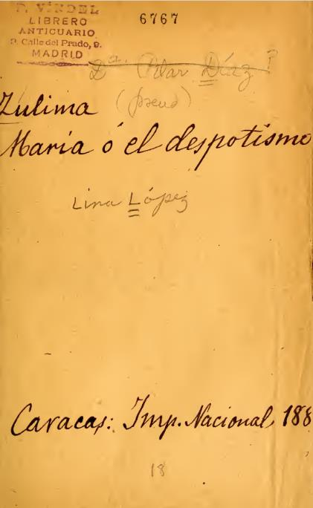
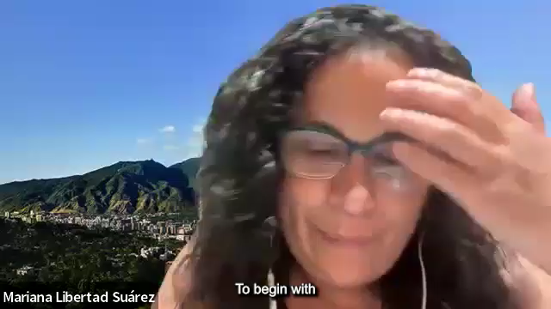
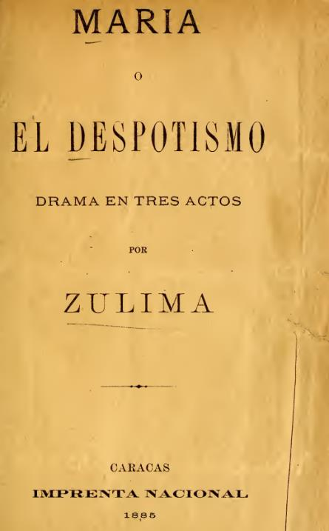
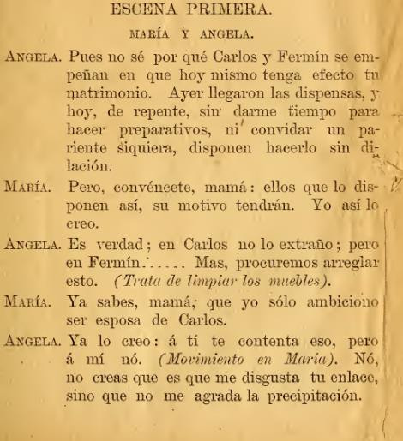
Who was Zulima?

Slide 7

The Venezuelan reality

Slide 8
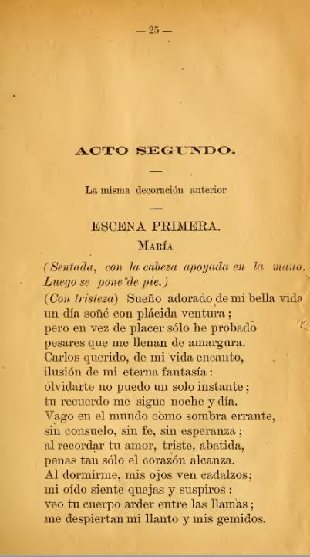
What can we do?
How can we do it with zero budget?

Slide 9
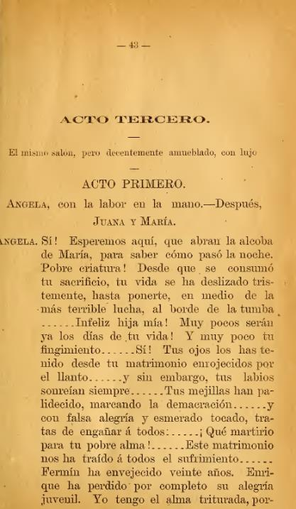
What we need
Cataloguing (metadata management) solution
Storage
Access platform:
  For the digital objects
  For the metadata
Goal: Preservable and findable

Slide 10
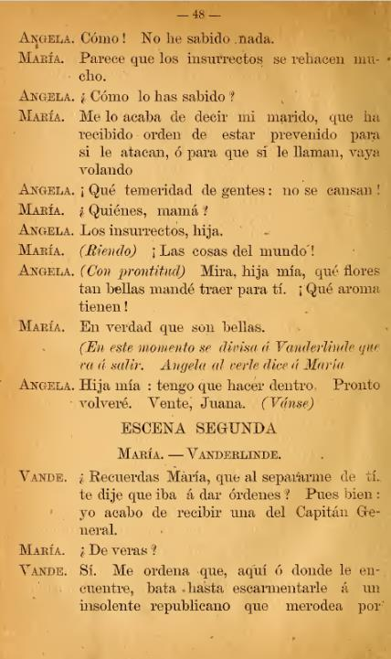
How-to manual
Introduction to archival principles
How to use the solution
Multiple languages
Open textbook format

Slide 11
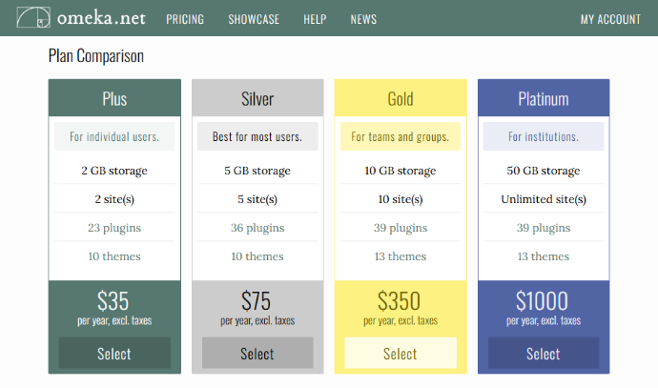
What we don't need
Licence fees
Recurring costs, e.g., hosting, support, etc.
Expensive hardware requirements, like high end computers or scanners

Slide 12
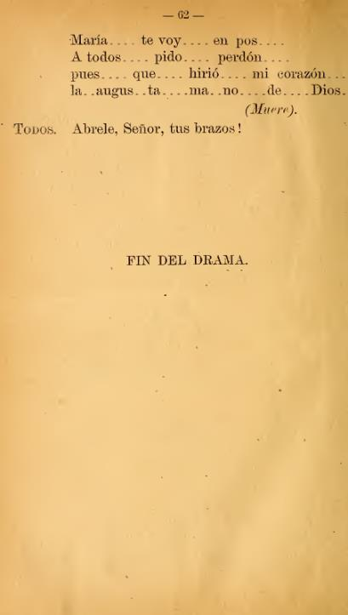
Our (technical) proposal
Cataloguing (metadata management) solution: SWALLOW running locally
Storage:
GitHub, Internet Archive, Flickr Commons
Access Platform:
  For the digital objects: MACAW hosted on GitHub Pages
  For the metadata: WikiData

Slide 13
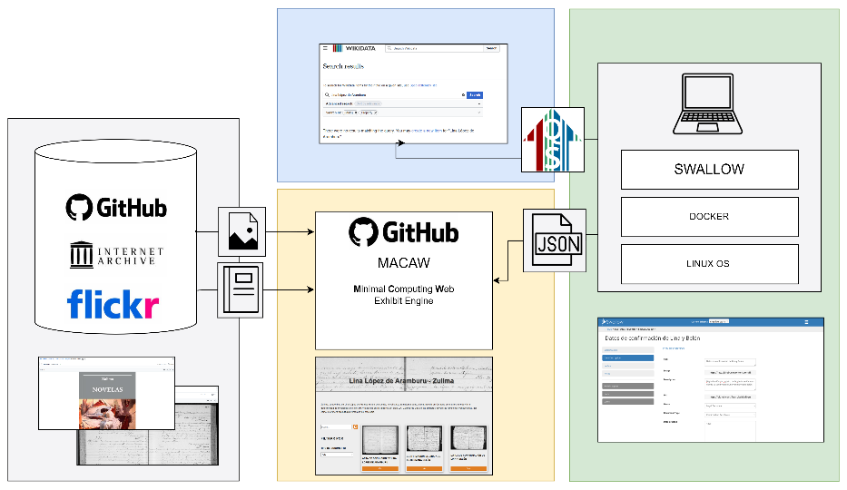
Systems Architecture

Slide 14
